Slide 1
Establishing Process of National Standard System and Role of System Developer (국가 표준 시스템의 구축 및 담당 조직의 역할)
Lee, Wan-Jae
Korea Institute of Civil Engineering and Building Technology

Slide 2
Establishing Process of National Standard System and Role of System Developer
Table of Contents
I. Who will play a Main role for developing Codes & Standards?
II. What kind of Code and Standard Systems will we develop?
III. Why are Codes and Standards Living Documents?
IV. How to create Project-specified Specifications?

Slide 3
I. Who will play a Main role for developing Codes & Standards?
Main Developer of Standards & Codes in Korea
Past: Before 2016 Present: After 2016
Total Plan & Control
Total Control
Government
(MOLIT)
Advise
& Approval
Government
(MOLIT)
Advise
& Approval
NCTIC
Check & Review
Check & Review
Check & Review
(NCTIC)
Request
& Instruct
Instruct
& Request
Plan, Draft & Revise
Main Developer
(Prof. Ogzns)
Main Developer
(KCSC)
Draft & Revise
Submit
Submit
Professional Organizations
-Academic Institutes
-Industry Expert Associations
KCSC: Korea Construction Standard Committee
composed of members from
-Academics, Industry experts, Research fellows
MOLIT: Ministry of Land, Infrastructure and Transport
NCTIC: National Construction Technology Inquiry Committee

Slide 4
I. Who will play a Main role for developing Codes & Standards?
Past Main Developers of Standards & Codes in Korea (Before 2016)
Main Developers | Design Standards | Constructi-on Standards | Main Developers | Design Standards | Constructi-on Standards | Main Developers | Design Standards | Constructi-on Standards
1. Korean Society of Civil Engineers |  | Civil Works Urban Railway Construction | 9. Society of Aircondition, Refrigerating | Architectural Mechanical Works Design | Architectural Mechnical Works(HVAC) | 17. Seoul Municipality |  | Special Specification for City Works
2. Korea Concrete Institute | Concrete Structure Design | Concrete Works | 10. Society of Steel Construction | St’l Structure D. LRFD Design Method design |  | 18. Korea Rual Community Corporation | Agricultural Production Infra System D. | Agricultural Civil Engineering W.
3.Architectural Institute of Korea | Architectural Structure Design | Architectural Construction | 11.Earthquake Engineering Society | Seismic Design |  | 19. Korea Land & Housing Corporation |  | Housing Construction Special Spec.
4. Korean Geotechnical Society | Structure Foundation Design |  | 12. Institute of Illuminating & Electrical | Architectural Electrical System Design | Architectural Electrical Works | 20. Korea Water Coprporation |  | Dam & Water Supply System Special Spec.
5. Korean Institute of Landscaping | Landscaping Design | Landscaping Works | 13. Temporary Equipement Association |  | Temporary & False Works | 21. Korea Expressway Corporation |  | Expressway Construction Special Spec.
6. Korea Road Association | Road Design Road Bridge D. Limit State D. | Road Construction Road Bridge C. | 14. Water & Wastewater Association | Drinking Water Wastewater Facility Design | Drinking Water & Wastewater Facility Works | 22. D. Minister for Tech. Policy |  | Construction Environmental Management
7. Korean Tunneling Association | Tunnel Design | Tunnel Construction | 15. Ports & Harbors Association | Port & Fishery Harbor System design | Port & Fishery Harbor System Construction | 23. Authority of Infrasafety structure | Earthworks for Slope & Utility Tunnel Designs | Earthworks for Slope & Utility Tunnel Constru.
8. Water Resource Association | River Design Dam Design | River & Channel Works | 16. Korea National Railway | Railway System Design | Railway System Construction | 24. Authority for New Capital City |  | Special Spec. for New Capital City

Slide 5
I. Who will play a Main role for developing Codes & Standards?
Present Main Developers of Standards & Codes in Korea (After 2016)
Main Developers (Korea Construction Standards Committee) | Design Standard Code (KDS 00 00 00) | Construction Specification Code (KCS 00 00 00) | Construction Standards Committee | Design Standard Code (KDS 00 00 00) | Construction Specification Code (KCS 00 00 00)
1.Overall standards Committee | Overall (KDS 10 00 00) | Overall (KCS 10 00 00) | 12.Architecure design standards Committee(30) | Architecture (KDS 41 00 00)
2.Geotechnical standards Committee(30) | Geotechnical construction (KDS 11 00 00) | Geotechnical construction (KCS 11 00 00) | 13.Architecture Construction standards Committee(30) |  | Architecture (KCS 41 00 00)
3.Concrete standards Committee(30) |  |  | 14.Road standards Committee(30) | Road (KDS 44 00 00) | Road (KCS 44 00 00)
4.Steel construction standards Committee(30) | Steel construction (KDS 14 00 00) | Steel construction (KCS 14 00 00) | 15.Utility Tunnel standards Committee
5.Earthquake-resistant standards Committee(30) | Earthquake-resistant (KDS 17 00 00) | Earthquake-resistant (KCS 17 00 00) | 16.Railroad standards Committee
6.Temporary equipment standards Committee(28) | Temporary equipment (KDS 21 00 00) | Temporary equipment (KCS 21 00 00) | 17.Railroad standards Committee | Railroad (KDS 47 00 00) | Railroad (KCS 47 00 00)
7.Bridge standards Committee(30) | Bridge (KDS 24 00 00) | Bridge (KCS 24 00 00) | 18.River and Dam standards Committee | River (KDS 51 00 00) Dam (KDS 54 00 00) | River (KCS 51 00 00) Dam (KCS 54 00 00)
8.Tunnel standards Committee(30) | Tunnel (KDS 27 00 00) | Tunnel (KCS 27 00 00) | 19.Water and Sewage standards Committee | Water (KDS 57 00 00) Sewage (KDS 61 00 00) | Water (KCS 57 00 00) Sewage (KCS 61 00 00)
9.Machinery equipment standards Committee(35) |  |  | 20.Harbor and Fishing Port standards Committee | Harbor and Fishing Port (KDS 64 00 00) | Harbor and Fishing Port (KCS 64 00 00)
10.Electric-facilities standards Committee(30) | Facilities (KDS 31 00 00) | Facilities (KCS 31 00 00) | 21.Agricultural facility standards Committee | Agricultural facility (KDS 67 00 00) | Agricultural facility (KCS 67 00 00)
11.Landscape standards Committee(30) | Landscape (KDS 34 00 00) | Landscape (KCS 34 00 00)

Slide 6
I. Who will play a Main role for developing Codes & Standards?
Main Developer of Standards & Codes in United States
-US does not have national building code
-Individual jurisdictions are responsible for
developing, managing, and enforcing their own
building code
-Private developers are independent of the
Jurisdictions responsible for enacting the code
Under their Acts, Law & Regulations
Governments
(By Jurisdictions)
Jurisdictions
-Federal
-State
-County
-City(Municipal)
Adopt & Enact
(incl: modify & develop)
ANSI
(American National
Standard Institute)
Voluntary accreditation body representing public and private sector standards developing organizations
Accredit & Designate
Various Private Developers
(Model Codes &
Reference Standards)
Coordinates
Private Code & Standard Development Organizations
-Academic Institutes, Industry or Technical Societies
-Design Professionals
-Construction Industry Representatives
-Manufacturers
-Local Officials
-Other Stakeholders
Independently fully develops

Slide 7
I. Who will play a Main role for developing Codes & Standards?
Main Developers of Reference Standards & Model Codes in USA
AA: Aluminum Association
AAMA: American Architectural Manufacture Association
ANLA: American Nursery and Landscape Association
AASHTO: American Association of State Highway and
Transportation Officials
ACI: American Concrete Institute
AFBMA: Anti-Friction Bearing Manufactures Association
AGMA: American Gear Manufacturer Association
AHA: American Hardboard Association
AIA: American Institute of Architects
AIAA: American Institute of Aeronautics and Astronautics
AIEE: American Institute of Electrical Engineers
AISC: American Institute of Steel Construction
AITC: American Institute of Timber Construction
ALSC: American Lumber Standards Committee
AMCA: American Movement and Control Association
MHIA: Material Handling Industry of America
ANS: American Nuclear Society
ANSI: American National Standards Institute
API: American Petroleum Institute
AREMA: American Railway Engineering and Maintenance Ass.
ARI: American Conditioning and Refrigeration Institute
ASAE: American Society of Agricultural Engineers
ASCE: American Society of Civil Engineers
ASHRAE: American Society of Heat, Refri, Aircon Engineers
ASME: American Society of Mechanical Engineers
ASNT: American Society for Nondestructive Testing
ASQC: American Society for Quality Control
ASSE: American Society of Sanitary Engineers
ASTM: American Society of Testing and Materials
AWI: Architect Woodwork Institute
AWMA: Aluminum Window Manufacturers Association
AWPI: American Wood Preservers’ Institute
AWS: American Welding Society
AWWA: American Water Works Association
BHMA: Builders Hardware Manufacturers Association
BIFMA: Business and Institutional Furniture Manufacturers As.
CAPPA: Crusher and Portable Plant Association
CEC: Consulting Engineers Council
CEMA: Conveyor Equipment Manufacturers Association
CGA: Compressed Gas Association
CMAA: Crane Manufacturers Association of America
CRSI: Concrete Reinforcing Steel Institute
CSI: Construction Specification Institute
DFPA: Douglas Fir Plywood Association
EIA: Electronic Industries Association
FCI: Flood Controls Institute
FMS: Factory Manual System
HIMA: Health Industry Manufacturers Association
HPMA: Hardwood Plywood Manufacturers Association
HPSSC: Health Physics Society Standards Committee
HTI: Hand Tools Institute
ICC: International Code Council
ICEA: Insulated Cable Engineers Association

Slide 8
I. Who will play a Main role for developing Codes & Standards?
Main Developers of Reference Standards & Model Codes in USA
IEEE: Institute of Electrical and Electronics Engineers
IES: Illuminating Engineering Society
IIAR: International Institute of Ammonia Refrigeration
IME: Institute of Makers of Explosives
IPC: Institute of Printed Circuits
IPCEA: Insulated Power Cable Engineers Association
ISA: Instrument Society of America
ISANTA: International Staple, Nail and Tool Association
ISDSI: Insulated Steel Door Systems Institute
ISEA: Industrial Safety Equipment Association
ISO: International Organization for Standardization
ITE: Institute of Traffic Engineers
MBMA: Metal Building Manufacturers Association
MSS: Manufacturers Standardization Society
NAAMM: National Ass. of Architectural Metal Manufacturers
NBS: National Bureau of Standards
NEC: National Electrical Code
NEMA: National Electrical Manufacturers Association
NFPA: National Fire Protection Association
NFSA: National Fertilizer Solution Association
NKCA: National Kitchen Cabinet Association
NPC: National Plumbing Code
NRC: Nuclear Regulatory Commission
NSPE: National Society of Professional Engineers
NWMA: National Woodwork Manufacturers Association
NWWDA: National Wood Window and Door Association
OPEI: Outdoor Power Equipment Institute
OSHA: Occupational Safety and Health Administration
PCA: Portland Cement Association
PDCA: Painting and Decorating Contractors of America
PFI: Pipe Fabrication Institute
PPI: Plastic Pipe Institute
PTI: Power Tool Institute
RIA: Robotic Industries Association
RMA: Rubber Manufacturers Association
SAE: Society of Automotive Engineers
SAMA: Scientific Apparatus Makers Association
SDI: Steel Door Institute
SEM: Society of Experimental Mechanics
SJI: Steel Joint Institute
SMACNA: Sheet Metal and Air Conditioning Contractors Nat
SMPTE: Society of Motion Picture and Television Engineers
SNT: Society for Nondestructive Testing
SPI: Society of Plastics Industry
SSPC: Steel Structures Painting Council
UL: Underwriters Laboratories
VRCI: Factory Manual System
Vol. Prod. Std: Variable Resistive Components Institute
WPCF: Water Pollution Control Federation
The list provides the names of the more prevalent organizations that establish model codes and reference standards in US

Slide 9
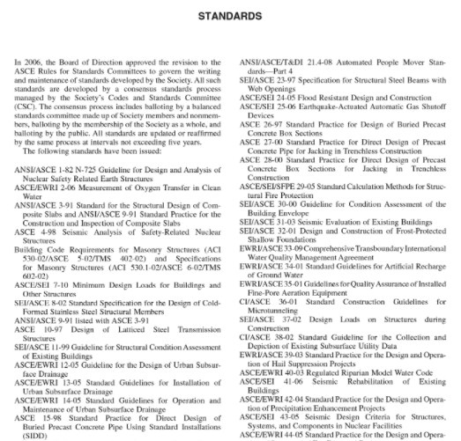
I. Who will play a Main role for developing Codes & Standards?
ASCE as A Main Developer of Reference Standards in USA
Governments
(By Jurisdictions)
ASCE’s Reference Standards
ANSI
(American National
Standard Institute)
Adopt & Enact
Accredit & Designate
CSC/ASCE
(Code & Standards
Committee)
Coordinates
Develop
Reference Standards
① ASCE has no authority to enforce
compliance with its standards.
② ASCE’s reference standards are
registered in US patent and trade
mark office.

Slide 10
I. Who will play a Main role for developing Codes & Standards?
ICC as A Main Developer(Agency) of Model Codes in USA
ICC’s Model Codes
(International Code Council)
Governments
(By Jurisdictions)
ANSI
(American National
Standard Institute)
IBC: International Building Code
IRC: International Residence Code
IPMC: International Property Maintenance Code
ISPSC: International Swimming Pool and Spa Code
IMC: International Mechanical Code
IFC: International Fire Code
IFGC: International Fuel Gas Code
IEBC: International Existing Building Code
IPC: International Plumbing Code
IECC: International Energy Conservation Code
IPSPC: International Private Sewage Disposal Code
IWUIC: International Wild land - Urban Interface Code
IZC: International Zoning Code
Adopt & Enact
Accredit & Designate
ICC
(International
Code
Council)
Coordinates
Develop
Model Codes
① Model codes are developed by private code agencies for subsequent adoption by local and state government
agencies as legally enforceable regulations.
② The model codes have no force of law unto themselves. Only after adoption by a government agency are they
enforceable under the police powers of the state.

Slide 11
II. What kind of Code and Standard Systems will we develop?
By Good
Technology
For Public
Interest
Definition of Building Code
A set of rules of procedure and standards of materials designed to secure uniformity and protect the public interest in such matters as building construction and public health, established usually by a public agency and commonly having the force of law in a particular jurisdiction. (Webster’s Dictionary)
● Relationship between Building Codes and Standards
A Building Code establishes a jurisdictional “floor” relative to occupants’ health, safety, and welfare.
A Building Standard is a “standard practice” often referred to within the codes.
With Legal
Enforcement
A set
of
rules
of
procedure
and
standards
of
material
Purpose
Bldg Code
For
Jurisdictional Floor
For
Health. Safety,
Welfare
For
What you must do
(mandatory)
Choose
Choose
Choose
Choose
Compliance
Compliance
Compliance
Compliance
Bldg Standard
By
Standard Practice
Material, Design,
Method
How you do it
By
By
Means

Slide 12
II. What kind of Code and Standard Systems will we develop?
Distinction between Code and Standard
Example in Fire System
Code:
What you must do
Do we must install sprinklers? Yes or no?
Regulations for the purpose of safety
Standard:
Guide on How you do it
If yes, guide on sprinkler head flow rates, spacing, operation temperature, durability, etc.
Means for compliance with the Regulations
Code Developing Process
Material, Design, Method
Satisfactory to and Compliant with
Code Requirements
Public Interest for
Health, Safety, Welfare
Jurisdictional
Legal Requirement
Various
Reference Standards
By Developers
Various
Model Codes
By Agencies
Jurisdictional
Codes
By Governments
Choose
Adopt
Modify
Add
Develop
ASCE
ASTM
ACI
AASHTO
ANSI
ICC
NEC
NPC
FEDERAL
STATE
COUNTY
MUNICIPALITY
AHJ: Authorities Having Jurisdictions

Slide 13
II. What kind of Code and Standard Systems will we develop?
Major Code and Standard Systems in the World (APEC)
Korea Code System
T
O
P
D
O
W
n
Central Government
(MOLIT)
. Mandatory Codes
compliant with building
regulations are developed
and provided under
control of Central
Government
. Similar in Japan, Taipei,
Chile, Peru, Vietnam,
China, Indonesia
Regulations
Enact
Mandatory Code developed alongside building regulations by the Central Government
Direct
Control
Submit
Develop
Mandatory Code
By KCSC
Draft
B
O
T
T
O
M
U
p
Regulations
Governments
(Jurisdictions)
Mandatory
Enforcement
. No National Building
Code are provided by
Central Government
. Individual Jurisdictions
are responsible for
providing their own
building codes
. Model Codes become
mandatorily enforceable if
they are adopted by
Jurisdictional
Governments
. Similar in Canada,
Australia
US Code System
Choose
Adopt
adopt
Model Code developed separate from building regulations of Jurisdictions
Develop
Model Codes
By Private Ogzns
No Mandatory
. HK does not have a Code System
. Building regulations do not cite code, but all
standards and Codes of practice are strongly
recommended
. Building regulations are mandatory and are the
minimum standard required
. Failure to comply with some of the regulations is
considered a criminal act
. Similar in Brunei, Singapore, Malaysia
Hong Kong Code System
Building regulations specify use of best practice and standards but allow equivalent

Slide 14
III. Why are Codes and Standards Living Documents?
Codes and Standards change depending on different Times and Regions
Times
Regions
Codes and Standards
With advances in
-Technology
-Economy
-Globalization
With Characteristics in
-Natural Condition
-Social System
-Legal Regulation
Constantly
Changes and Different
Codes and Standards are Living Documents.
It is subject to regular review and comment cycles.
A new codes and standards are published at regular intervals, usually every three to five years.
With advances in technology, competition, and the globalization of our economy, it is critical
that building codes be dynamic and provide a pathway for the approval of new and innovative
materials, designs, and methods of construction.
All too often practitioners assume that codes and standards they have been using in one
jurisdiction are the same as these in new local for their practice.
That is often not the case and can lead to a lack of code compliance for some projects.

Slide 15
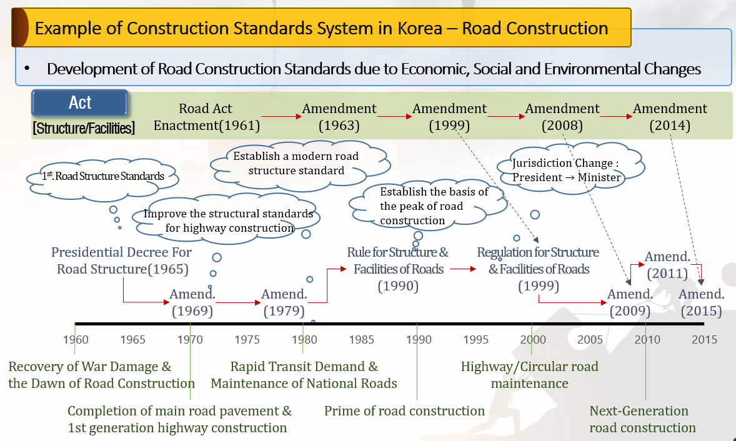
III. Why are Codes and Standards Living Documents?
Codes and Standards change depending on different Times in Korea
With Development of Economic Situation in Korea
30300$
Global Financial Crisis
from U.S.
20800$
▲Per Capita GNI(us$)
To Join
OECD
IMF
Bailout
`02 FIFA
World Cup
The World Bank(2021.2)
`88 Olympic
10090$
120$
1280$
2030$
`86 Asian Game
5380$
Revision History of Korea Standards
With Advances in Technology
Structure Foundation Design
Architectural Structure Design
Revision | Contents
Dec. 1971 | First Edition
Nov. 1986 | Regulation Change
Dec. 2002 | Technology Development
Nov. 2008 | Regulation Change
Feb. 2014 | New Technology & Method
May. 2016 | Sinkhole Problem
Revision | Contents
Apr. 2005 | First Edition
Aug. 2009 | Regulation Change
Dec. 2009 | Partial Change
Dec. 2013 | Regulation Change
Oct. 2015 | Snow Load Change
May. 2016 | Performance-Based Design Method

Slide 16
III. Why are Codes and Standards Living Documents?
Codes and Standards change depending on different Times in Korea
Times
Regions
Codes and Standards
With advances in
-Technology
-Economy
-Globalization
With Characteristics in
-Natural Condition
-Social System
-Legal regulation
Constantly
Changes and Different
▲Per Capita GNI(us$)
Appearance and Establishment of
Various Code Developing organizations
(Academic Institutes and Professional Associations)
30300$
20800$
1990’s
1970’s
1980’s
10090$
5380$
120$
1280$
2030$
(1966) Korea Road Association
(1989) Korea Concrete Institute
(1945) Architectural Institute of Korea
(1984) Korean Geotechnical Institute
(1992) Korean Tunneling Association
(1951) Korea Society of Civil Engineers
(1996) Earthquake Engineering Society
(1972) Korea Institute of Landscape Archite.
(1989) Korea Society of Steel Construction
(1976) Korea Ports & Habors Association
(1987) Korea Institute of Illuminating
(1969) Korea Expressway Corporation
(1971) Society of Air-Conditioning, Refriger.
(1967) Korea Water Resources Association
(1967) Korea Water Corporation(K-Water)
(1962) Korea Housing Corporation
(1975) Korea Land Corporation
(1992 Korea National Railway
(1996) Korea Temp. Equipment Association
(1995) Korea Authority of Land & Infrrasafety
(1970) Korea Rural Community Corporation
(2001) Korea Water & Wastewater Association

Slide 17
III. Why are Codes and Standards Living Documents?
Codes and Standards change depending on different Times in Korea
Times
Regions
Codes and Standards
With advances in
-Technology
-Economy
-Globalization
With Characteristics in
-Natural Condition
-Social System
-Legal regulation
Constantly
Changes and Different
Development of Science & Technology | Structural Engineering Design Methods | Steel Structure Design Standard | Road Bridge Design Standard | Concrete Structure Design Standard | Concrete Structure Foundation Design Standard
Conventional Design Methods (Material-Based) | Limit Design Method (강도설계법) |  | Basic Method for Concrete (2010) | Basic Method
 | Allowable Stress Design Method (허용응력설계법) | Basic Method (2004) | Basic Method for Steel (2010) |  | Basic Method (2008)
New Design Methods (Performance-Based) | Load & Resistance Factor Design Method (하중저항계수설계법/ASSHTO) | New Adoption (2009)
 | Limit States Design (한계상태설계법/CEN) |  | New Adoption For Conc’ & Steel (2012)
Inconsistency between
Upper and Lower Structure
Design Methods

Slide 18
III. Why are Codes and Standards Living Documents?
Heirarchical Order Structure of Codes and Standards in Korea
For Road & Highway
Legal Regulations
BY Government
(MOLIT)
Law(법) | Road & Expressway
Presidential Decree(대통령령) | Road Decree Expressway Decree
Enforcement Regulations(부령) | Structure & facility Regulations
Instructions(훈령) | Disaster Prevention, Environmental-friendly
Decrees
Acts
Laws
Approval
& Adoption
Control
By Gov.
Upper Level
Technical Specification
BY Code & Standard
Developers
Now: Korea Standard Committee
Past: Professional Organizations
National Design Standards | Road, Road Bridge, Structure Foundation River & Stream Concrete Structure, Tunnel
National Construction Standards | Road, Civil Works, Road Bridge, Concrete, Tunnel
National Design Standards
National Construction Standards
Report
& Approval
Reference
No Control By Gov.
Lower Level
Technical Specification
BY Professional Organizations
Academic Institutes
Industry Expert Associations
Government owned Corporations
Know-how for Road Design practice, Guideline for Planning of Road Alignment, Handbook for Environmental-friendly Road, Standard Drawing for Retaining Walls, Manual for Road Structures & Facilities, Know-how for prevention of Frost Heaving, Manual for Mountainous Road design, Guideline for Interchange Planning, Standard Drawing for Soundproof Walls Guideline for Road Drainage System
Guideline(지침)
Handbook(편람)
Know-How(요령)
Manual(해설)
Standard Drawings(표준도)
Special Specifications(특별시방서)

Slide 19
IV. How to create Project-specified Specifications?
Three Basic Bidding or Contract Documents for Actual Construction Projects
Bidding & Contract Requirements
Drawings
Specifications (Project-specific)
National Codes & Standards
(Design & Construction
Based on DB&B, DB, EPC-TK)
Methods for Writing
Specifications
Standardized Formats
Specifications
Contents
Project-Specified
Specifications
Writing
Structure

Slide 20
IV. How to create Project-specified Specifications?
Methods for Writing Specifications
National Codes & Standards
(Design & Construction
Based on DB&B, DB, EPC-TK)
Four Methods of Specifying
Descriptive Specification
Reference Standard Specification
Proprietary Specification
Performance Specification
Methods for Writing
Specifications
Contents
Standardized Formats
Specifications
Writing
Project-Specified
Specifications
Structure
1. Descriptive Specifying
Exact properties of materials and methods of
installation are described in detail without using
proprietary names
2. Reference Standard Specifying
Reference is made to established standards to
which the specified products and processes shall
comply or conform
3. Proprietary Specifying
Actual brand names, model numbers, and other
proprietary information are specified
4. Performance Specifying
Required results are specified and the criteria are
specified by which the performance will be verified

Slide 21
IV. How to create Project-specified Specifications?
Standardized Formats for Specifications
CSI Master Format
Master Format is the specifications-writing
standard for building design and Construction
projects developed by
the Construction Specification Institute (CSI)
National Codes & Standards
(Design & Construction
Based on DB&B, DB, EPC)
Methods for Writing
Specifications
Contents
Standardized Formats
Specifications
Writing
Project-Specified
Specifications
Structure
Structure of CSI Masterformat
Number System of CSI Masterformat
Level 1 Groups(2)
Level 2 Sub-Groups(5)
Level 3 Divisions(49)
Level 4 Detailed Works & Materials
Level 5 Sub-Detailed W & M
Level 6 Sub-Sub-Detailed W & M
Level 7 User-defined Contents
Level 3 31 00 00 Earthwork
Level 4 31 41 00 Shoring
Level 5 31 41 16 Sheet Pile
Level 6 31 41 16 13 Steel Sheet Pile
Level 7 31 41 16 13 01 User defines

